Slide 1
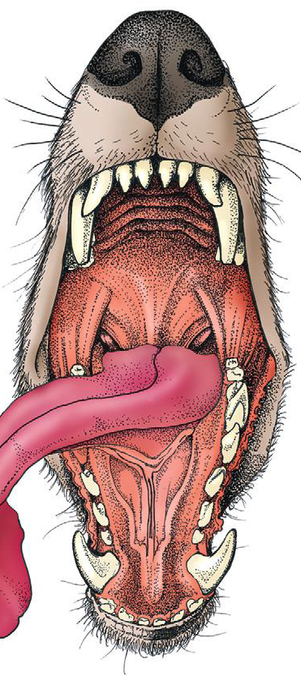
Oropharynx surgery Esophageal surgery
Assis. Prof. Dr. Rafid Majeed Naeem

Slide 2
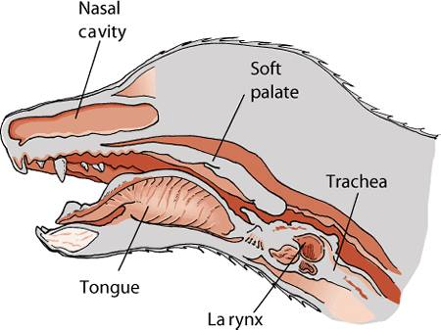
Oropharynx: The space ventral to the soft palate bound caudally by the pharyngeal wall.
The soft palate helps protect the nasopharynx from entrance of food during deglutition by becoming taut and elevated
This action results in the caudal free edge of the soft palate pressing on the pharyngeal wall, sealing off the nasopharynx.

Slide 3
Physiology of Deglutition
Swallowing, also called deglutition, is the transport of food or water from the mouth to the stomach
The entire process of deglutition has been divided into three phases:
oropharyngeal,
esophageal, and
gastroesophageal.

Slide 4
The oropharyngeal phase has been further subdivided into the oral, pharyngeal, and pharyngoesophageal stages.
The oral stage involves formation of a food bolus by compression of food between the tongue and palate. The bolus is then propelled toward the base of the tongue at the entrance of the pharynx.
2. The bolus at the base of the tongue stimulates the reflex pharyngeal stage of deglutition. The tongue and pharyngeal constrictor muscles transport the food bolus through the pharynx through a peristaltic-like manner.
To prevent food from entering the airway, the epiglottis covers the glottis, and the soft palate presses against the pharyngeal wall to block the entrance to the nasopharynx.

Slide 5
3. The passage of food from the pharynx through the cricopharyngeal sphincter and into the esophagus is the pharyngoesophageal stage of deglutition.
Relaxation of the sphincter starts as soon as the pharyngeal muscles begin constriction. The degree of sphincter opening varies with the size and consistency of the bolus.
The pharyngoesophageal stage terminates with closure of the sphincter and relaxation of the pharyngeal constrictor muscles.

Slide 6
GENERAL CONSIDERATIONS
Clinical Signs and Diagnostics
General clinical signs of oral disease include
ptyalism (an abnormal and excessive secretion of saliva.),
dysphagia (a difficulty in swallowing ),
inappetence (reduction or complete loss of appetite),
weight loss,
pain,
halitosis (Bad mouth smell), and
oral hemorrhage.

Slide 7
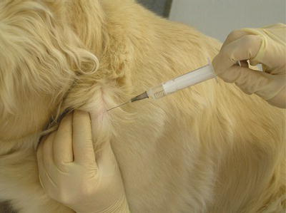
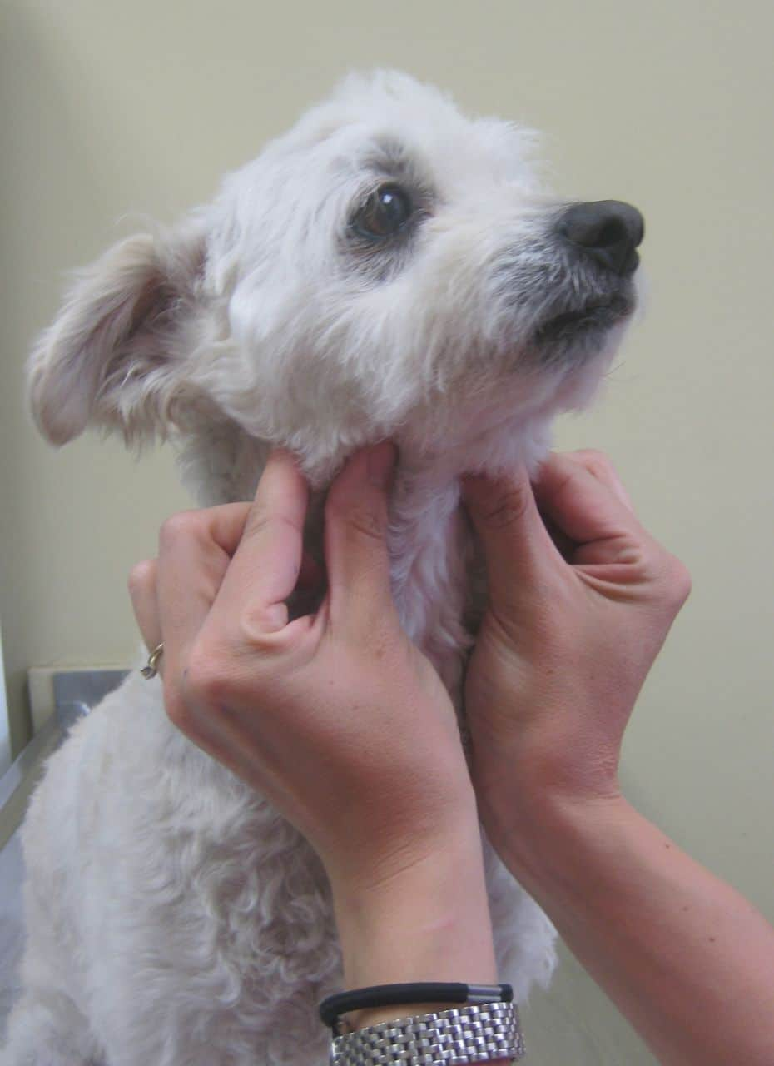
In patients known or suspected to have oral neoplasia, cytologic evaluation of fine needle aspirates taken from mandibular lymph nodes is recommended.
Medial retropharyngeal lymph nodes are palpable only when they are significantly enlarged.

Slide 8
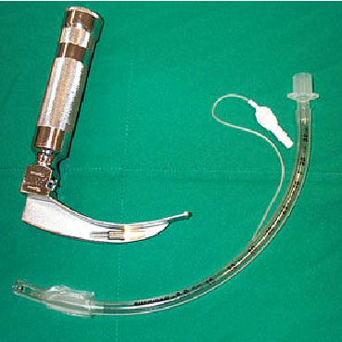
Preoperative Preparation
When anesthetizing patients with large masses or for those that have already displayed signs of dyspnea, instruments for performing an emergency tracheotomy should be available.
An appropriately sized endotracheal tube (with a properly inflated cuff), along with absorbent material packed in the back of the pharynx, will usually prevent significant leakage into the trachea.

Slide 9
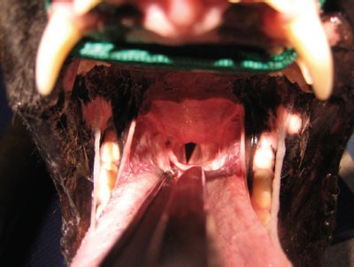
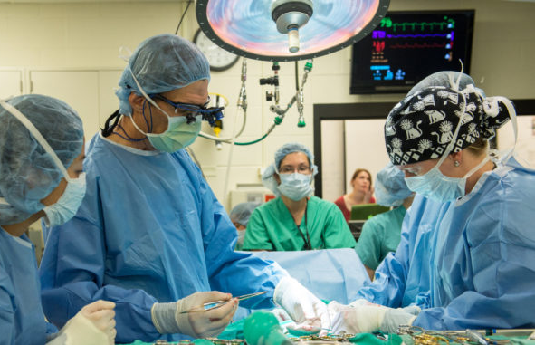
Visualizing the pharynx and evacuating any fluid with a suction tube immediately before extubation may also help prevent fluid aspiration
Povidone– iodine solution or a 0.2% chlorhexidine solution is used for preparation of the oral mucosa.
Perioperative antibiotics are generally not indicated because the mouth is remarkably resistant to infection, presumably because of its excellent blood supply and the antibacterial properties of saliva.

Slide 10
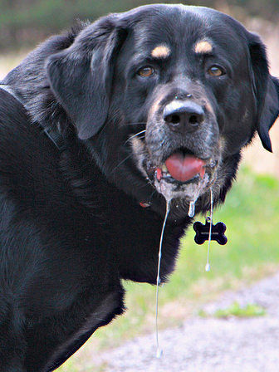
DISORDERS OF THE OROPHARYNX
Dysphagia
Dysphagia: is difficulty swallowing during any stage of deglutition
Symptoms of dysphagia affecting the oral stage of deglutition may include difficulty prehending food or lapping water; retention of food or water in the mouth; and failure to swallow saliva, resulting in drooling.
Some animals are able to compensate by making sudden head movements while eating in an attempt to move food back into the pharynx.
If other stages of deglutition are normal, animals with oral stage dysphagia may benefit from feeding and providing water in an elevated position to aid delivery of food and water to entrance to the pharynx.

Slide 11
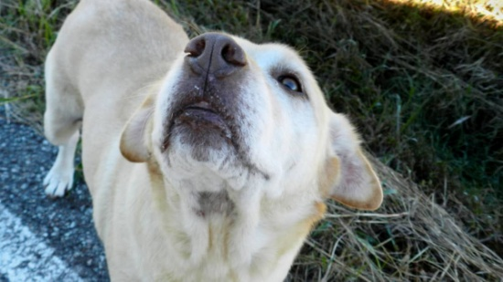
Clinical features of dysphagia during the pharyngeal or pharyngoesophageal stages usually include repeated unsuccessful attempts at swallowing.
Food may be regurgitated back into the oral cavity or may stay in the pharynx.
Because the epiglottis relaxes at the termination of swallowing and leaves the airway unprotected, affected animals are at risk for laryngotracheal aspiration.
In animals with dysphagia of the pharyngeal or pharyngoesophageal stage, function is not improved by feeding in an elevated position or placing food at the base of the tongue.

Slide 12
Etiology and Diagnosis
Dysphagia usually results from
space-occupying masses,
structural congenital abnormalities, or
functional abnormalities.
Structural Abnormalities and Masses. Structural congenital abnormalities resulting in dysphagia include congenital palate defects, ankyloglossia (limited normal movement of the tongue chiefly due to an abnormally shortened frenulum : tongue-tie), macro- and microglossia,
Space-occupying masses resulting in dysphagia include extrapharyngeal masses, such as enlarged retropharyngeal node(s), cervical abscess or granuloma

Slide 13
Treatment depends on the specific cause. A mass in the oral cavity may not cause any symptoms until it reaches a critical size, subsequently resulting in
drooling,
difficulty in food prehension, or
malodor.
Pharyngeal masses that result in an acute onset of dyspnea require:
rapid decompression (e.g., incisional drainage of mucoceles) or
intubation to quickly unobstruct the airway.
Dysphagia from penetrating injuries may occur from the presence of a foreign body or swelling, pain, or infection associated with the trauma.

Slide 14
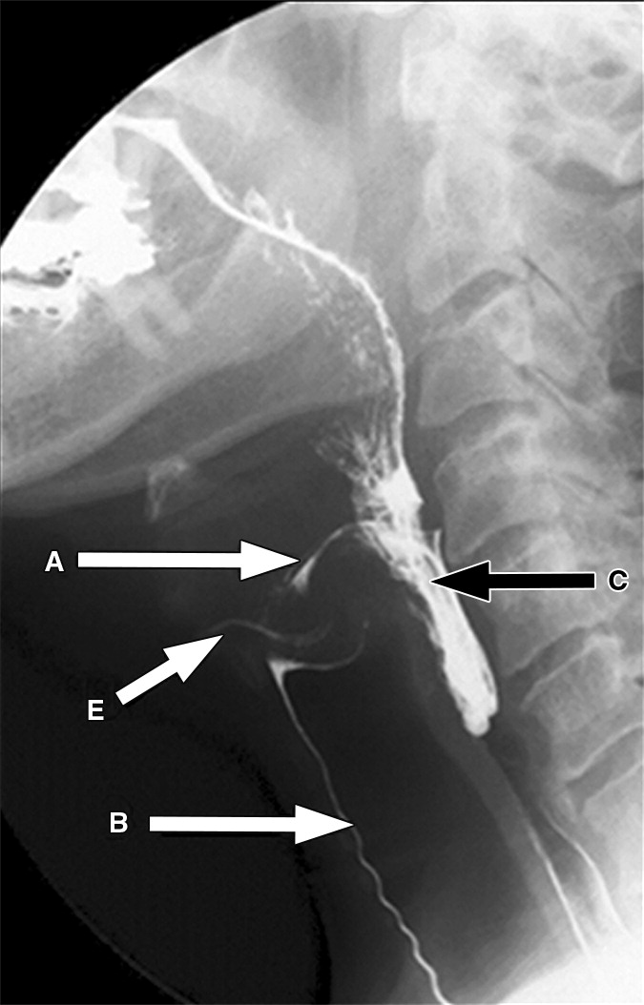
Fluoroscopic evaluation of the swallowing process using barium contrast is the most useful tool in diagnosing

Slide 15
Penetrating Injuries to the Oropharynx
Penetrating trauma to the mouth from foreign objects is sometimes seen in dogs that carry or chew sticks and is seen rarely in cats.
Diagnostics
Plain radiographs of the cervical region
Common sites of penetration are
the esophagus,
lateral and dorsal pharyngeal walls,
sublingual region.
The decision to use advanced imaging is based on the chronicity of the injury, the presence of cervical swelling, and radiographic signs of gas or tissue reaction within the cervical region.

Slide 16
Surgery
Wound exploration, debridement, and lavage may be adequate treatment in most cases of penetrating trauma without extraluminal pharyngeal involvement.
The goal of surgery in penetrating injury of the pharynx: is to
locate and remove foreign material,
obtain tissue or fluid samples for cytology and culture,
debride nonviable tissue,
establish drainage if necessary.
administration of antibiotics is usually indicated if infection is suspected.
Therapy can be modified after culture and sensitivity results are available.

Slide 17
Esophageal surgery

Slide 18
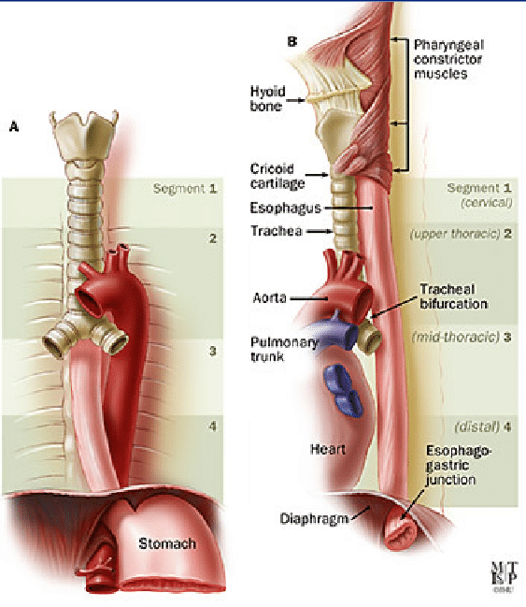
Esophagus
The esophagus is the connecting tube between the pharynx and stomach that functions to transport ingesta and fluids.
The outer layer of the esophagus is the adventitia.
In the neck, The esophageal adventitia blends with the deep cervical fascia.
In the thorax and abdomen, the adventitia is largely covered with pleura and peritoneum.
The esophagus is loosely connected to the diaphragm by a phrenicoabdominal membrane.

Slide 19
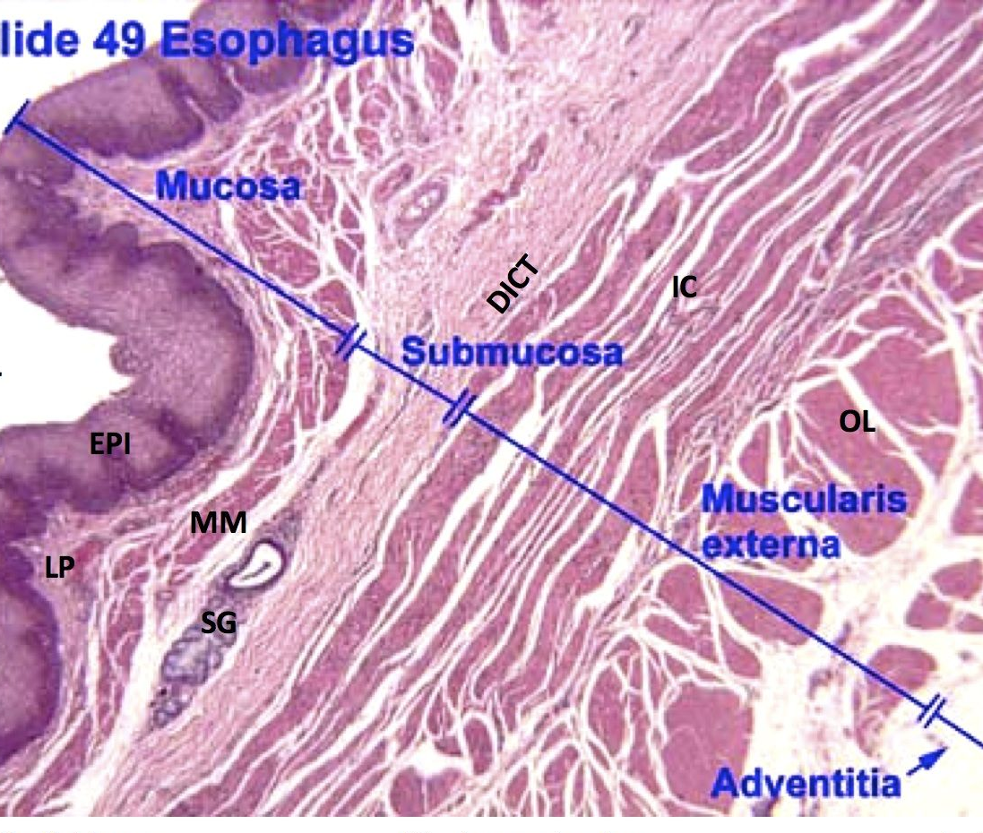
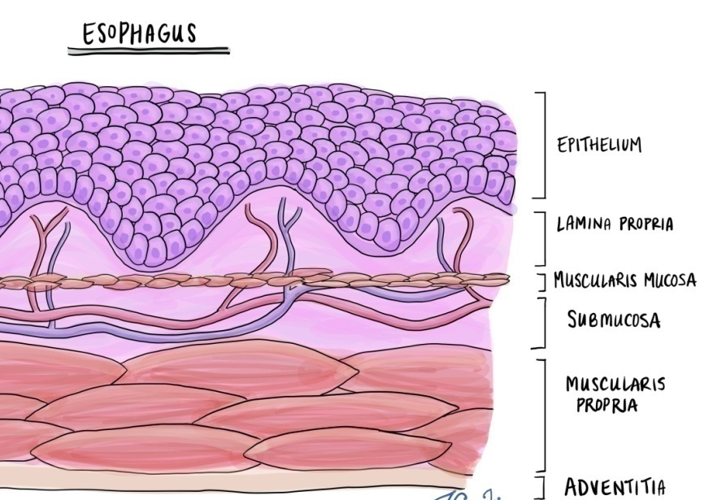
esophagus
The muscularis is composed of striated muscle for the entire length of the esophagus in dogs, but it changes to smooth muscle in the terminal esophagus in cats.
The submucosa loosely connects the mucosa and muscularis, allowing mucosa to move independently and form mucosal folds in the undistended esophagus.
The submucosa contains blood vessels, nerves, and simple mucous glands that secrete mucus, which lubricates the mucosal surface.
The esophageal mucosa is composed of a stratified squamous epithelium.

Slide 20
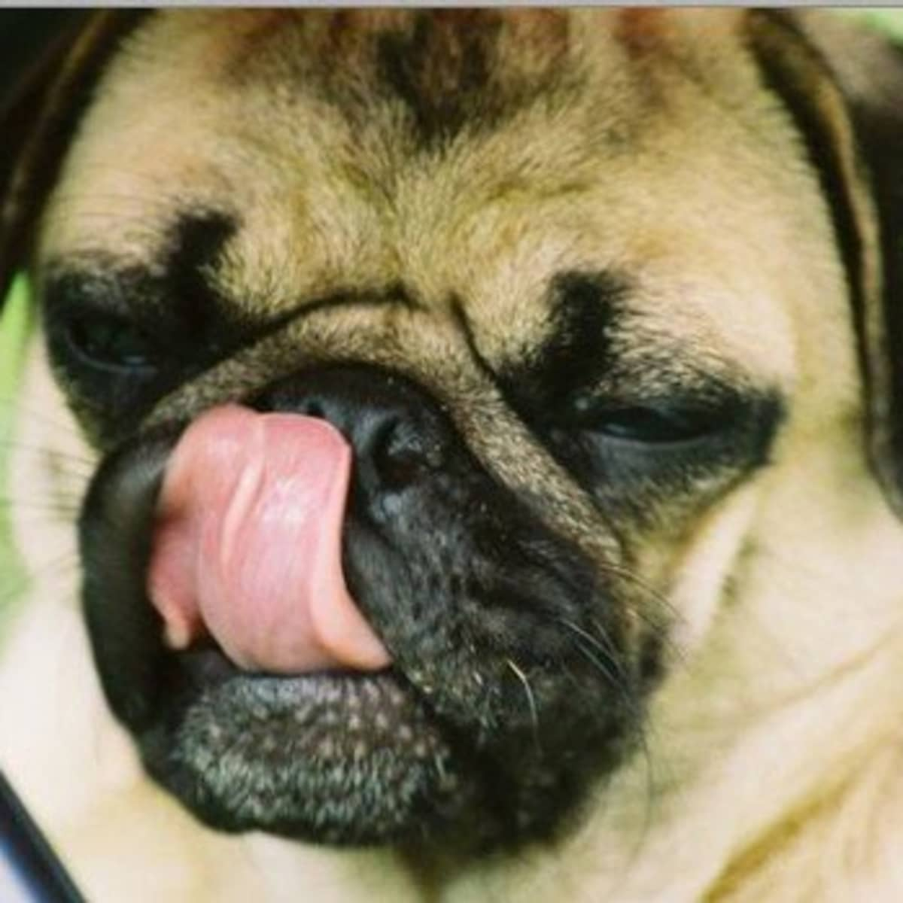
Causes of dysfunction of the esophageal phase of swallowing are divided into
1. mechanical or anatomic lesions: (mural lesion or compression from adjacent structures like foreign bodies or tumors)
2. functional or neuromuscular lesions (neuromuscular disease commonly causes megaesophagus)
3. inflammatory (esophagitis) conditions (include ingestion of corrosive substances, thermal burns, radiation injury, and esophageal foreign bodies.)

Slide 21
GENERAL SURGICAL PRINCIPALS
Esophageal surgery is associated with a higher incidence of incisional dehiscence than surgery on other portions of the alimentary tract.
In esophageal surgery, several factors may contribute to the high complication rate, including
lack of serosa,
the segmental nature of the blood supply,
the lack of omentum,
constant motion caused by swallowing and respiration,
tension at the surgical site.

Slide 22
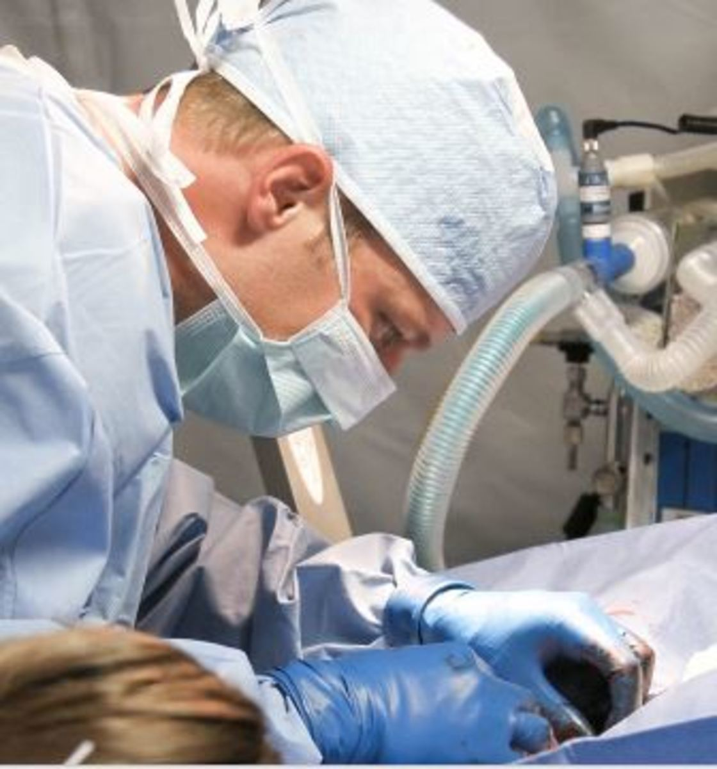
esophageal surgery can be successfully performed by following principles, including
gentle tissue handling,
minimization of contamination,
appropriate selection and application of suture materials,
appropriate use of electrocautery
accurate apposition of tissues.
In the abdomen, the serosa assists in healing of viscera by the elaboration of a fibrin seal soon after surgery and by providing a source of pluripotential mesothelial cells.
In the thoracic cavity, pleural mesothelium may play a similar role.

Slide 23
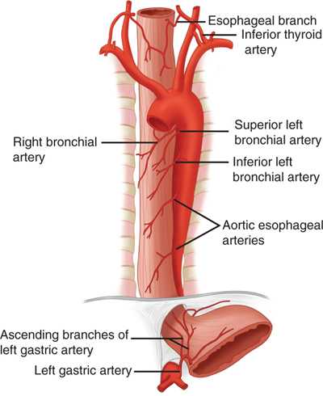
The blood supply to the esophagus is considered segmental
يعني غني بالاوعية الدموية ..ينزف اثناء الفتح
Postoperative motion of the esophageal incision with swallowing and respiration is unavoidable.
But after esophageal surgery, food and water are normally withheld to reduce esophageal motion and eliminate the passing of ingesta across the surgical site.

Slide 24
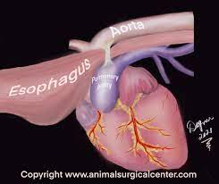
DISEASES OF THE ESOPHAGUS
Vascular Ring Anomalies
Vascular rings are developmental anomalies of the great vessels that result in the encircling of esophagus by a complete or incomplete ring of vessels.
*Several types of vascular ring anomalies are described in dogs and cats. The most common vascular ring anomaly is persistent right aortic arch with a left ligamentum arteriosum,
الشذوذ الأكثر شيوعًا في الحلقة الوعائية هو قوس الأبهر الأيمن المستمر مع الرباط الشرياني الأيسر ،
The clinical signs of vascular ring anomalies are caused primarily by esophageal obstruction. Initially, regurgitation usually occurs soon after eating, but later it may occur at variable time (minutes to hours).

Slide 25
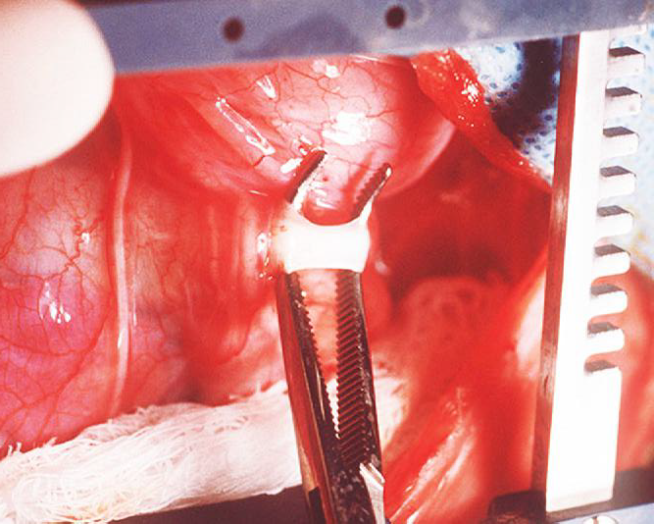
Treatment
Most vascular ring anomalies can be corrected through a left lateral thoracotomy.
The ligamentum arteriosum is carefully dissected from the esophagus with right-angled forceps double ligated with silk suture, and transected.
Prognosis with surgical correction of persistent right aortic arch with left ligamentum arteriosum in dogs has improved over the past several decades.

Slide 26
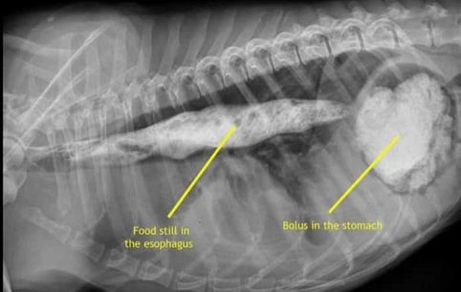
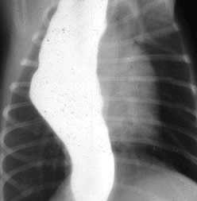
Congenital Generalized Megaesophagus
Idiopathic مجهول السبب congenital total megaesophagus is caused by generalized alteration in motor function of the esophagus, possibly from a defect in vagal afferent innervation of the esophagus, and results in lack of aboral propulsion of foodنقص في دفع الطعام اللاإرادي
The entire esophagus becomes dilated, and esophagitis may develop as a result of fermentation of retained food.
Treatment :
Esophagodiaphragmatic cardioplasty using the Torres technique to improve esophageal emptying.

Slide 27
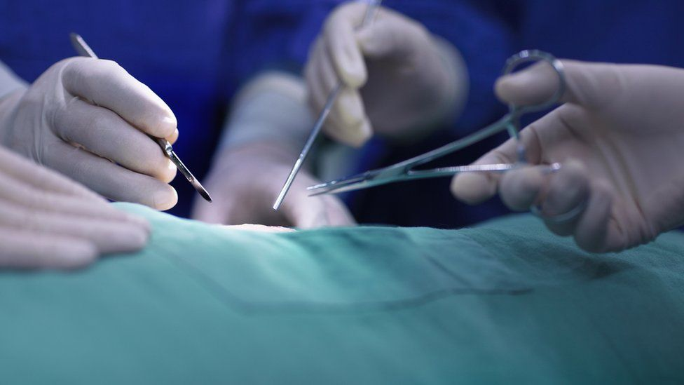
Esophagodiaphragmatic cardioplasty
The esophagus was approached through a ninth left intercostal thoracotomy and isolated with moistened saline sponges. The vagus nerves were identified and avoided. The diaphragm was dissected free of the left half of the esophagus at the esophageal hiatus, and a semicircular shaped segment of diaphragmatic muscle (2 to 3 cm wide) was resected. The new diaphragmatic edge was sutured to the esophagus with full-thickness horizontal mattress sutures of 2-0 polypropylene. A final layer of sutures (3-0 absorbable monofilament) was placed to close any remaining gaps in the diaphragm
cardioplasty places light tension on the distal esophagus; with contraction and relaxation of the diaphragm during respiration, the cardia also underwent intermittent contraction and dilatation, resulting in a pumping mechanism that helped drain the esophagus.
Prognosis : good

Slide 28
Esophageal Foreign Bodies
Esophageal foreign bodies are a common problem in dogs and are occasionally diagnosed in cats. The most common foreign bodies in dogs are ingested bones. In cats, fishhooks, needles, and string foreign bodies are more common.
Small-breed dogs, particularly terrier breeds, are most frequently diagnosed with esophageal foreign bodies. Most affected dogs are younger than 3 years of age (64%)

Slide 29
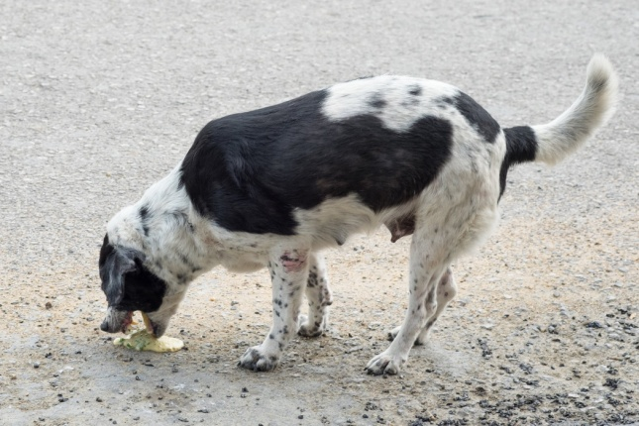
Esophageal Foreign Bodies
The most classic clinical sign is regurgitation of food within a few minutes of eating.
Other clinical signs include retching التهوع, gagging, excessive salivation, restlessness, lethargy، والأرق, and inappetence
Chronically affected animals may remain bright and alert but have weight loss and periodicبشكل دوري bouts نوباتof regurgitation and inappetence.
Sharp or chronic foreign bodies can result in esophageal perforation,

Slide 30
Treatment
An initial attempt should be made to extract the foreign body with endoscopy using grasping forceps.
يجب القيام بمحاولة أولية لاستخراج الجسم الغريب بالتنظير الداخلي أو التنظير الفلوري باستخدام ملقط الإمساك
the firmly lodged foreign body should not be forced because this may induce or enlarge a perforation. Then Surgical repair of perforations should be considered
لا ينبغي إجبار الجسم الغريب المستقر بقوة لأن هذا قد يؤدي إلى حدوث ثقب أو تكبيره.
Esophageal foreign bodies should be surgically removed when
retrieval or advancement of the foreign body fails or
when forceps extraction presents a significant risk for laceration of the esophagus or major vessels
يجب إزالة الأجسام الغريبة من المريء جراحيًا عند فشل استرجاع أو تقدم الجسم الغريب أو عندما يمثل استخراج الملقط خطرًا كبيرًا على تمزق المريء أو الأوعية الرئيسية
Prognosis
The prognosis after foreign body removal is generally excellent except in cases of thoracic esophageal perforation

Slide 31
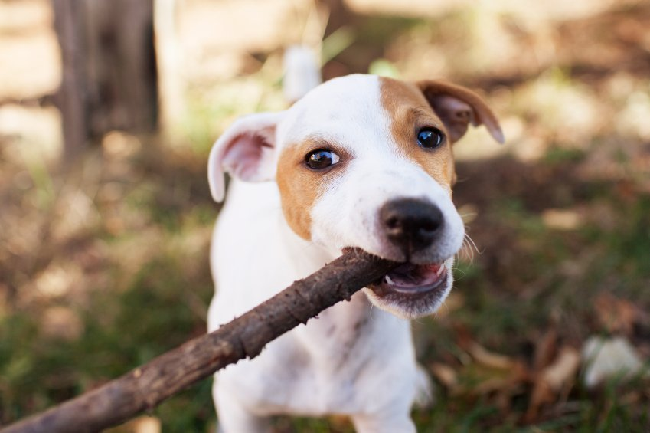
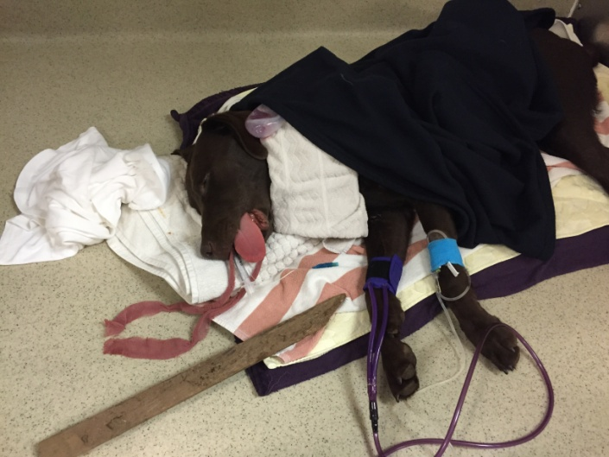
Esophageal Lacerations
Esophageal lacerations are most commonly caused by penetrating esophageal foreign bodies. The most common injury is a penetrating stick injury in dogs that carry, chew, or retrieve sticks. Esophageal stick injuries generally occur in the cervical esophagus.
Esophageal lacerations can also occur with external trauma such as bite wounds
Treatment
Foreign material is removed surgicaly, the esophageal laceration is minimally debrided, and a single- or double layered closure performed. The surgical site is lavaged before closure, and a closed suction drain can be placed.
Acute esophageal penetrating injuries have a poorer prognosis

Slide 32
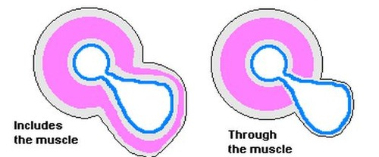
Esophageal Diverticula
Esophageal diverticula are rare in dogs and cats.
Diverticula are divided into pulsion and traction types.
A pulsion diverticulum is an outpouching of mucosa that herniates through a defect in the tunica muscularis. It is thought to be caused by increased luminal pressure as a result of a mechanical (e.g., foreign body or stricture) or functional esophageal obstruction..
A traction diverticulum is a full-thickness deviation of the esophageal wall. The term traction refers to the assumed pathogenesis, namely inflammation in an adjacent organ causing formation of an adhesion. Subsequent contraction of the adhesion pulls the esophagus outward to form a pouch
The diverticulum can become impacted with ingesta, distorting and obstructing the esophageal lumen

Slide 33
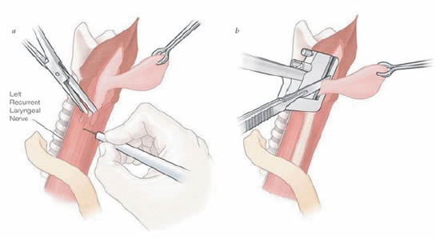
Treatment
Small diverticula may be treated conservatively by feeding a gruel-type diet with the animal in an upright position
يمكن معالجة الرتج الصغير بشكل وقائي عن طريق تغذية نظام غذائي من نوع العصيدة مع الحيوان في وضع رأسي
Large diverticula generally require surgical management. Excision of the diverticulum (diverticulectomy)

Slide 34
Esophageal Fistulae
An esophageal fistula is an abnormal communication between the esophagus and the trachea, bronchus, lung parenchyma, or (less commonly) the skin.
Esophageal fistulae may be either congenital or acquired.
most acquired fistulae are secondary to esophageal foreign bodies
The most common clinical sign is coughing, which may be associated with drinking liquids. Other clinical signs include regurgitation, lethargy, anorexia, dyspnea, and weight loss.

Slide 35
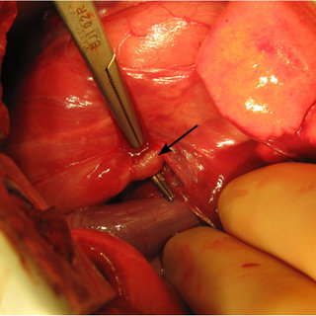
Treatment and Prognosis
Esophageal fistulae require surgical management. The esophageal defect can usually be closed primarily, although more extensive resection and reconstruction techniques may be required.

Slide 36
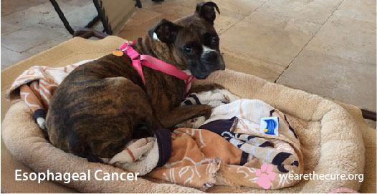
Esophageal Neoplasia
Esophageal neoplasia in dogs and cats is rare.
In dogs and cats, the most commonly reported primary esophageal tumors include squamous cell carcinoma,
Clinical Signs
The most common clinical sign is regurgitation or vomiting

